Slide 1


Slide 2
Crypto and e-Voting: Homomorphisms, Zero-Knowledge Proofs
Dan S. Wallach (Rice University)

Slide 3
Administrivia
Project 1: Going online tomorrow
Some coding, some written bits — get started early
Proper use of Piazza
Please don’t post partial solutions (code, hash values, etc.) without marking those posts as “private” to the instructors.

Slide 4
Our last crypto lecture!
On your own: go read up on how RSA works
Modern cryptographers seem to have concluded that DH-style is the way to go
Instead, this lecture is a whirlwind through several modern crypto topics
Zero-knowledge proofs
Mixnets
Homomorphic cryptography
Application to electronic voting
All of these things are deep topics
Your mission: understand some of the clever things that crypto can do

Slide 5
Reminder: Diffie-Hellman &
ElGamal Crypto

Slide 6
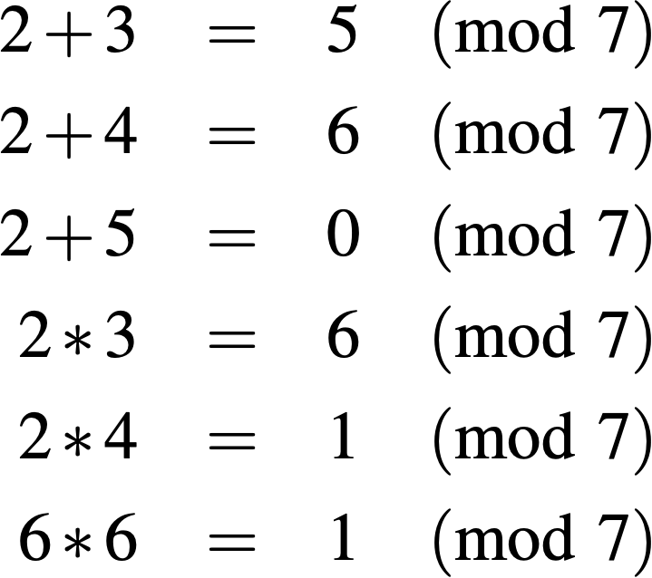
Modular arithmetic 101
We’re working in $Z_{p}^{*}$, the integers in [1, p)
Note: $Z_{p}^{*}$ is closed under multiplication but not addition.
Forbidden!
Notes:
$\mathbb{Z}_p^*$
\begin{eqnarray*}
2+3 & = & 5 \pmod{7} \\
2+4 & = & 6 \pmod{7} \\
2+5 & = & 0 \pmod{7} \\
2*3 & = & 6 \pmod{7} \\
2*4 & = & 1 \pmod{7} \\
6*6 & = & 1 \pmod{7}
\end{eqnarray*}

Slide 7
Modular arithmetic 101
In $Z_{p}^{*}$, we want to find generators such that $g^{1},g^{2},g^{3},…,g^{p-1}$
cover all the elements in the group.
Example, for p=7:
g=2 is not a generator, but g=3 is.
Notes:
$g^1, g^2, \ldots, g^{p-1}$

Slide 8
Discrete logarithms
Back to the regular integers, say I give you $q=5^{8437591243259543}$
and ask you to take $\log_{5}q$
Logarithms, over integers, are tractable. But what about in $Z_{p}^{*}$?
No known efficient solution to DLog problem.
Notes:
$q = 5^{8437591243259543}$
$\log_5 q$

Slide 9
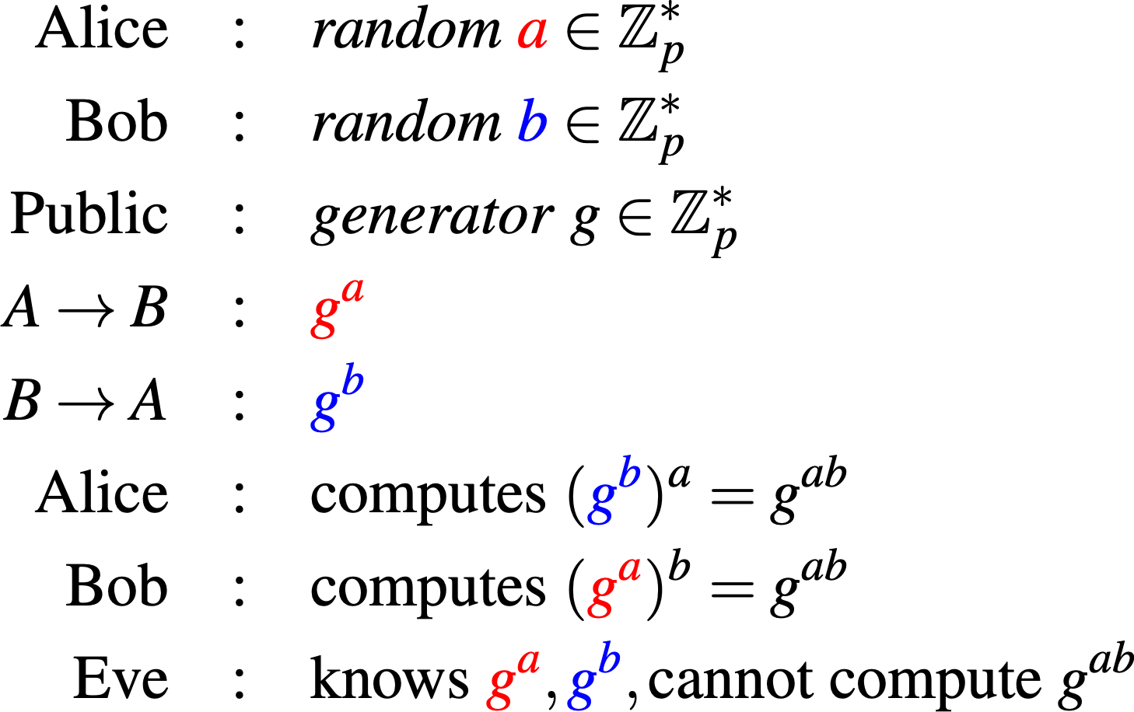
Diffie-Hellman (1976)
Notes:
\begin{eqnarray*}
\mathrm{Alice}&:& \mathit{random}\ \textcolor{red}{a} \in \mathbb{Z}_p^* \\
\mathrm{Bob}&:& \mathit{random}\ \textcolor{blue}{b} \in \mathbb{Z}_p^* \\
\mathrm{Public}&:& \mathit{generator}\ g \in \mathbb{Z}_p^*\\
A \rightarrow B&:& \textcolor{red}{g^a} \\
B \rightarrow A&:& \textcolor{blue}{g^b} \\
\mathrm{Alice}&:& \mathrm{computes}\ (\textcolor{blue}{g^b})^a = g^{ab} \\
\mathrm{Bob}&:& \mathrm{computes}\ (\textcolor{red}{g^a})^b = g^{ab} \\
\mathrm{Eve}&:& \mathrm{knows}\ \textcolor{red}{g^a}, \textcolor{blue}{g^b}, \mathrm{cannot\ compute}\ g^{ab}
\end{eqnarray*}

Slide 10
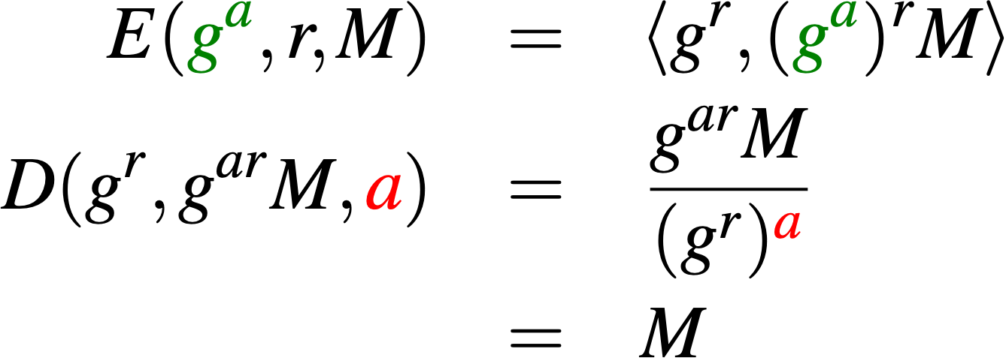
ElGamal encryption (1984)
Non-deterministic cryptosystem (different r every time)
g group generator
M plaintext (message)
r random (chosen at encryption time)
a (private) decryption key
gª (public) encryption key
Notes:
\definecolor{dgreen}{rgb}{0,0.5,0}
\begin{eqnarray*}
E(\textcolor{dgreen}{g^a},r,M) &=& \left<g^r, (\textcolor{dgreen}{g^a})^rM\right>\\
D(g^r, g^{ar}M, \textcolor{red}{a}) &=& \frac{g^{ar}M}{(g^r)^{\textcolor{red}{a}}} \\
&=& M
\end{eqnarray*}

Slide 11
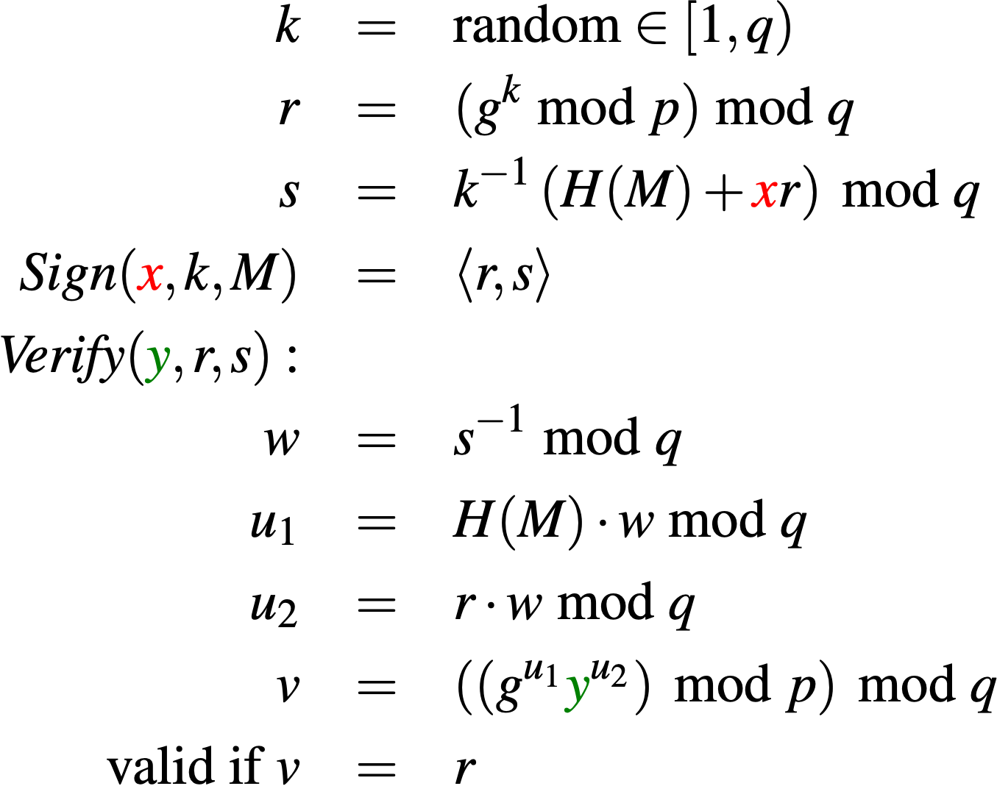
Digital signature algorithm (1991)
Similar idea to ElGamal encryption, just a bit more involved
g group generator
p large prime (1000+ bits)
q large-ish prime (~160 bits) divisible by p-1
M plaintext (message)
k random (chosen at encryption time)
x (private) decryption key (chosen randomly < q )
y=g^{x} (public) encryption key (mod p )
Fun: if k isn’t random and unique, attacker can recover x. (PS3 attack, Dec. 2010). Solution: derive k from x and H(M) deterministically. [RFC 6979]
Notes:
\definecolor{dgreen}{rgb}{0,0.5,0}
\begin{eqnarray*}
k &=& \textrm{random} \in [1,q) \\
r &=& (g^k\ \textrm{mod}\ p)\ \textrm{mod}\ q\\
s &=& k^{-1}\left(H(M) + \textcolor{red}{x}r\right)\ \textrm{mod}\ q\\
\textit{Sign}(\textcolor{red}{x},k,M) &=& \left<r, s\right>\\
\textit{Verify}(\textcolor{dgreen}{y},r,s,M):&& \\
w &=& s^{-1}\ \textrm{mod}\ q \\
% &=&k\left(H(M)+\textcolor{red}{x}r\right)^{-1}\ \textrm{mod}\ q \\
u_1 &=& H(M) \cdot w\ \textrm{mod}\ q\\
u_2 &=& r \cdot w\ \textrm{mod}\ q \\
v &=& \left(\left(g^{u_1}\textcolor{dgreen}{y}^{u_2}\right)\ \textrm{mod}\ p\right)\ \textrm{mod}\ q\\
\textrm{valid if}\ v &=& r
\end{eqnarray*}

Slide 12
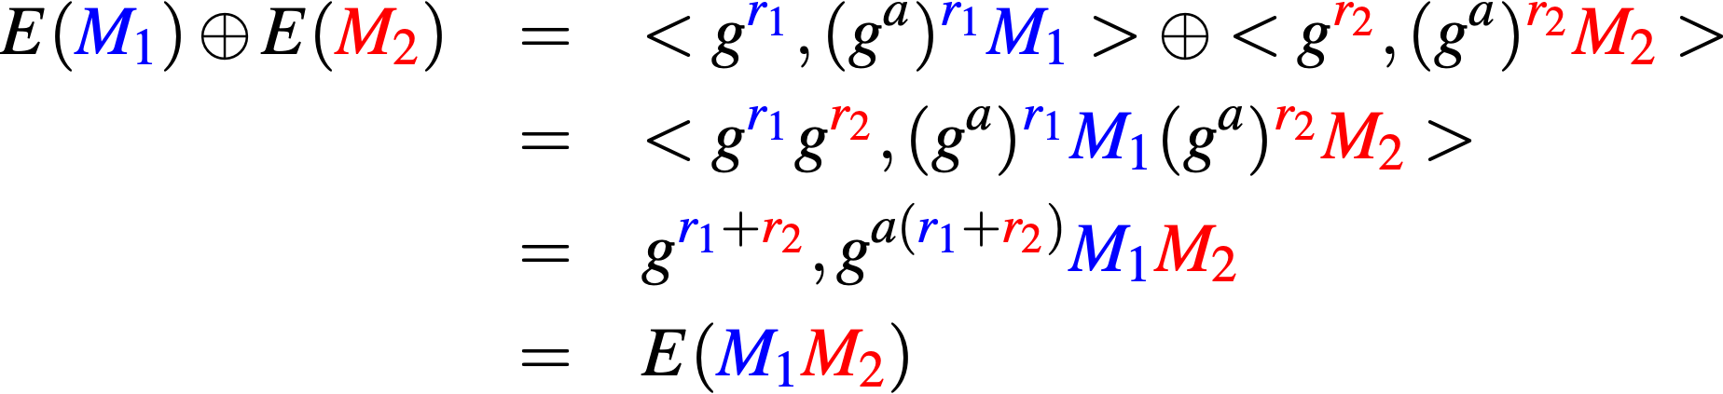
Homomorphic property
Anybody can combine two ciphertexts to get a new one.
g group generator
M plaintext (message)
r random (chosen at encryption time)
a (private) decryption key
gª (public) encryption key
Notes:
\begin{eqnarray*}
E(\textcolor{blue}{M_1}) \oplus E(\textcolor{red}{M_2}) &=& <g^{\textcolor{blue}{r_1}}, (g^a)^{\textcolor{blue}{r_1}} \textcolor{blue}{M_1}> \oplus <g^{\textcolor{red}{r_2}}, (g^a)^{\textcolor{red}{r_2}} \textcolor{red}{M_2}>\\
& = & <g^{\textcolor{blue}{r_1}}g^{\textcolor{red}{r_2}}, (g^a)^{\textcolor{blue}{r_1}} \textcolor{blue}{M_1}(g^a)^{\textcolor{red}{r_2}} \textcolor{red}{M_2}> \\
& = & g^{\textcolor{blue}{r_1}+\textcolor{red}{r_2}}, {g}^{a(\textcolor{blue}{r_1}+\textcolor{red}{r_2})} \textcolor{blue}{M_1}\textcolor{red}{M_2}\\
& = & E(\textcolor{blue}{M_1}\textcolor{red}{M_2})
\end{eqnarray*}

Slide 13
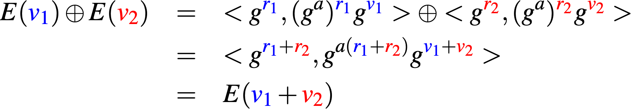
Homomorphic vote tallying
Change messages to counters, additive in exponent of g.
“Exponential ElGamal”
g group generator
v plaintext (counters)
r random (chosen at encryption time)
a (private) decryption key
gª (public) encryption key
Notes:
With ‘v’ instead of ‘c’:
\begin{eqnarray*}
E(\textcolor{blue}{v_1}) \oplus E(\textcolor{red}{v_2}) &=& <g^{\textcolor{blue}{r_1}}, (g^a)^{\textcolor{blue}{r_1}} g^{\textcolor{blue}{v_1}}> \oplus <g^{\textcolor{red}{r_2}}, (g^a)^{\textcolor{red}{r_2}} g^{\textcolor{red}{v_2}}>\\
& = & <g^{\textcolor{blue}{r_1}+\textcolor{red}{r_2}}, {g}^{a(\textcolor{blue}{r_1}+\textcolor{red}{r_2})} g^{\textcolor{blue}{v_1}+\textcolor{red}{v_2}}>\\
& = & E(\textcolor{blue}{v_1}+\textcolor{red}{v_2})
\end{eqnarray*}
With g only:
\begin{eqnarray*}
E(\textcolor{blue}{c_1}) \oplus E(\textcolor{red}{c_2}) &=& <g^{\textcolor{blue}{r_1}}, (g^a)^{\textcolor{blue}{r_1}} g^{\textcolor{blue}{c_1}}> \oplus <g^{\textcolor{red}{r_2}}, (g^a)^{\textcolor{red}{r_2}} g^{\textcolor{red}{c_2}}>\\
& = & <g^{\textcolor{blue}{r_1}+\textcolor{red}{r_2}}, {g}^{a(\textcolor{blue}{r_1}+\textcolor{red}{r_2})} g^{\textcolor{blue}{c_1}+\textcolor{red}{c_2}}>\\
& = & E(\textcolor{blue}{c_1}+\textcolor{red}{c_2})
\end{eqnarray*}
With f and g:
\begin{eqnarray*}
E(\textcolor{blue}{c_1}) \oplus E(\textcolor{red}{c_2}) &=& <g^{\textcolor{blue}{r_1}}, (g^a)^{\textcolor{blue}{r_1}} f^{\textcolor{blue}{c_1}}> \oplus <g^{\textcolor{red}{r_2}}, (g^a)^{\textcolor{red}{r_2}} f^{\textcolor{red}{c_2}}>\\
& = & g^{\textcolor{blue}{r_1}+\textcolor{red}{r_2}}, {g}^{a(\textcolor{blue}{r_1}+\textcolor{red}{r_2})} f^{\textcolor{blue}{c_1}+\textcolor{red}{c_2}}\\
& = & E(\textcolor{blue}{c_1}+\textcolor{red}{c_2})
\end{eqnarray*}

Slide 14
Violation of encryption semantics?
If I know and and
then I can find other messages where
I know their encryption!
Notes:
Old:
If I know $M_1$ and $M_2$ and
$E(\textcolor{blue}{M_1}) \oplus E(\textcolor{red}{M_2}) = E(\textcolor{blue}{M_1}\textcolor{red}{M_2})$
\newline
then I can find other messages where I know their encryption!
New:
$M_1$ \hspace{1.5em} $M_2$ \hspace{1.5em}
$E(\textcolor{blue}{M_1}) \oplus E(\textcolor{red}{M_2}) = E(\textcolor{blue}{M_1}\textcolor{red}{M_2})$

Slide 15
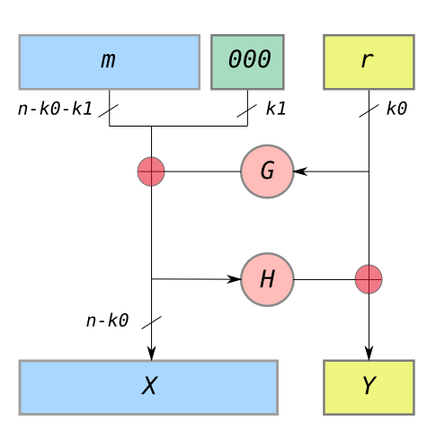
Solution: Padding
Optimal Asymmetric Encryption Padding (OAEP) - Belare and Rogaway (1995)
m - message (plaintext)
r - random number
G, H - cryptographic hash functions
X, Y - the message that gets encrypted
Notes:
Attacker can generate new ciphertexts, but when decrypted, the internal random number won’t match up.

Slide 16
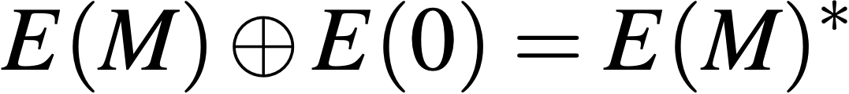
Cool trick: reencryption
Anybody can “reencrypt” a message.
(New random number introduced from E(0).)
Notes:
E(M) \oplus E(0) = E(M)^*

Slide 17
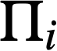

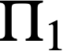
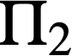
Reencryption mixnets
Permutations , where output is reencrypted.
Each mix permutes/reencrypts.
Must prove output corresponds to input.

Slide 18
Non-solution: reveal the mix
Publish the random numbers and the permutation.
Eliminates benefit of randomization.

Slide 19
Randomized partial checking
Effective across larger mixes.
(Jakobsson, Jules, Rivest ’02)
Say we’re mixing 1 million ballots, each mix reveals 1%. After five mixes, 99.99% chance that all ballots reencrypted at least once.
Notes:
Mention that there are many other ways of doing this. Could do a whole lecture on different sorts of reencryption mixes. This one just happens to be very easy to explain.

Slide 20
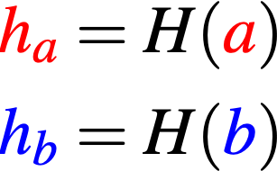
Hash functions
Widely used throughout cryptography.
Arbitrary string in.
Fixed-length string (e.g., 256 bits) out.
Usefulness: if ha ≠ hb then a ≠ b.
Pre-image resistance: given ha, it’s infeasible to derive a.
Second pre-image resistance: given a and ha, it’s infeasible to derive a'≠ a such that H(a') = H(a)
Notes:
\begin{eqnarray*}
\definecolor{dgreen}{rgb}{0,0.5,0}
\textcolor{red}{h_a} = H(\textcolor{red}{a}) \\
\textcolor{blue}{h_b} = H(\textcolor{blue}{b})
\end{eqnarray*}

Slide 21
Simple use of hash functions
Tamper resistant storage: we’ll store a and give you ha
Hash chains: if new records include the hash of older records, then keep the latest somewhere safe and verify all older records.
Commitments: in a game like rock-paper-scissors, both parties first send the hash of their move, then reveal the moves later. (But be sure to include a random number!)

Slide 22
Zero-knowledge proofs (ZKP)
want to prove you know something
while revealing nothing
generalized format
prover: commit to something (e.g., reencryption mix output)
verifier: challenge the prover
prover: respond to the challenge

Slide 23
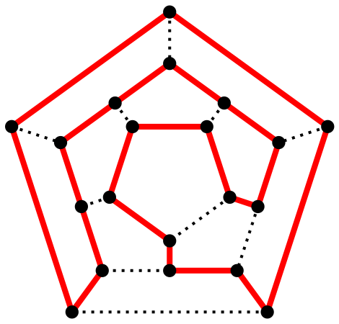
Example: Hamiltonian paths
Prover: “I know a HP over graph G.” Compute graph isomorphism H. Publish G, H.
Verifier: Coin toss. Heads: tell HP over H. Tails: tell isomorphism G to H.
(Repeat N times.)
If prover doesn’t know HP, verifier catches with high probability.

Slide 24
Non-interactive ZK proofs
Prover: Precompute N isomorphisms (H1 to HN) and hash them. Hash function yields coin tosses for virtual challenger. Then output the results.
(Assumes good hash functions.)
This is an example of the Fiat-Shamir heuristic (1986).
Notes:
General approach of hashing the initial messages: “Fiat-Shamir heuristic”

Slide 25
NIZK variant for mixes
Hash the output of the permutation/reencryption. Use those bits to select which edges get revealed.
Say we’re mixing 1 million ballots, each mix reveals 1%. After five mixes, 99.99% chance that all ballots reencrypted at least once.

Slide 26
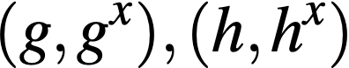
Evil machine: E(bignum)?
Must prove ciphertext corresponds to well-formed plaintext. (Example, prove counters are zero or one.)
We need another ZK tool: Chaum-Pedersen proofs.
Prover knows:
Wants to prove that these two tuples share x
But x is a secret!
Notes:
Applications of C-P proofs coming up in a minute. First, we need to explain how C-P works.

Slide 27
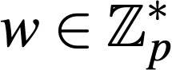
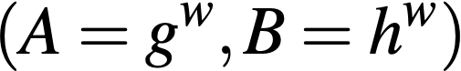
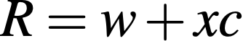
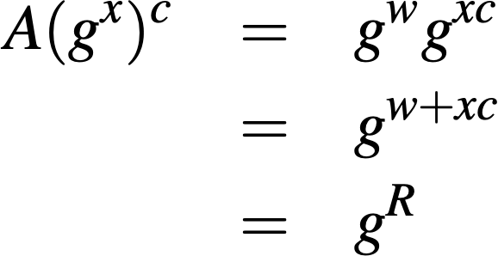
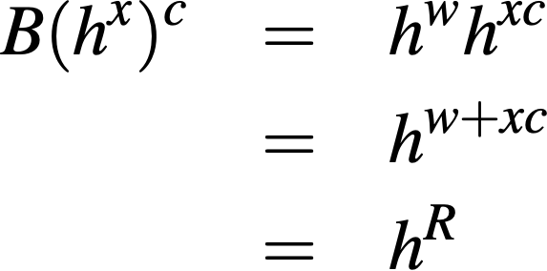
Chaum-Pedersen proofs (1992)
Goal: demonstrate
P: choose random , compute
Send (A,B) to V
V: pick a random number c (challenge), send to P
P: compute
send R to V
V: Compute

Slide 28
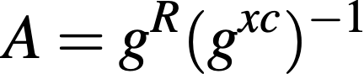
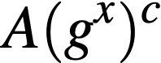
Fake C-P proofs?
Goal: demonstrate
P: choose random , compute
Send (A,B) to V
V: pick a random number c (challenge), send to P
P: compute
send R to V
V: Compute
P choses fake c, R s.t. .
Observer can compute ...
ZK protocols only work when “live” (or use Fiat-Shamir heuristic for non-interactive)
Notes:
1) We’re never going to know a value for w.
2) Instead, prover picks c and R arbitrarily, solves for A and B, never needs to know w, never computes R=w+xc

Slide 29
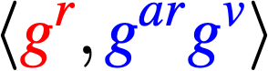
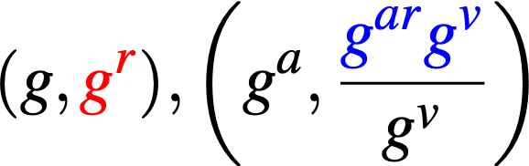
C-P for vote testing
Can I prove a vote is zero or one? First, how about “proving” it’s zero using C-P.
Want to verify for a specific value of v?
“Prove we know $r$” (or we could symmetrically prove we know $a$)
Do C-P protocol where becomes
We could do this for any value of v
Challenge is to do v = 0 and v = 1 at the same time.
Notes:
\left<\textcolor{red}{g^r}, \textcolor{blue}{g^{ar}g^v}\right>
(g,\textcolor{red}{g^r}), \left(g^a, \frac{\textcolor{blue}{g^{ar}g^v}}{g^v}\right)

Slide 30
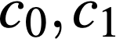
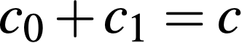
Cramer-Damgård-Schoenmakers (1996)
Can run two Chaum-Pedersen (or any two ZK proofs like this) simultaneously, one “real” and one “simulated”.
First, fake a proof (e.g., for v = 1) in advance.
Then, announce the first message for both protocols. Challenger sends c, prover announced a split
where , then executes both ZK protocols.
Verifier cannot tell which one was real vs. simulated, but knows that one of them was real.
Notes:
Three proofs needed.
1) prove you have a zero
2) prove you have a one
3) prove you have one or the other
If zero: do the proof for zero, fake the proof for one. (Pick the challenge you want for the “one” proof, fully generate the transcript.)
Challenge: prover decides how to split one challenge across the two proofs, XOR or add together the results.
Chaum-Pedersen for the 1 proof or zero proof.
(same generator everywhere, no ‘f’)
Combination: Cramer-Damgard-Shoenmaker ‘96

Slide 31
Crypto summary
At the end of the day, any election observer can now:
- verify every single ballot for being “well-formed”
(valid ElGamal tuple, encrypted zero-or-one, etc.)
- add together all the ballots (homomorphically)
- verify a proof of the tally (Chaum-Pedersen again)
(only the election authority can generate this)
But we have no idea if the original ciphertext corresponded to the intent of the voter (versus evil machine flipping votes).

Slide 32
One newer, useful trick:
ballot challenge

Slide 33
Catch a machine if it cheats!
Benaloh challenges [2006]
voter makes selections
voting machine commits irrevocably to the ballot to be cast
“cast”
voter’s
choice
“challenge”
confirmed
(ballot is cast)
show commitment
(ballot is spoiled)
Notes:
So, to review:
It’s really important that the machine, at the time of commitment, not be able to tell whether the voter will challenge
STRESS that the machine can’t tell that this is a test scenario.

Slide 34
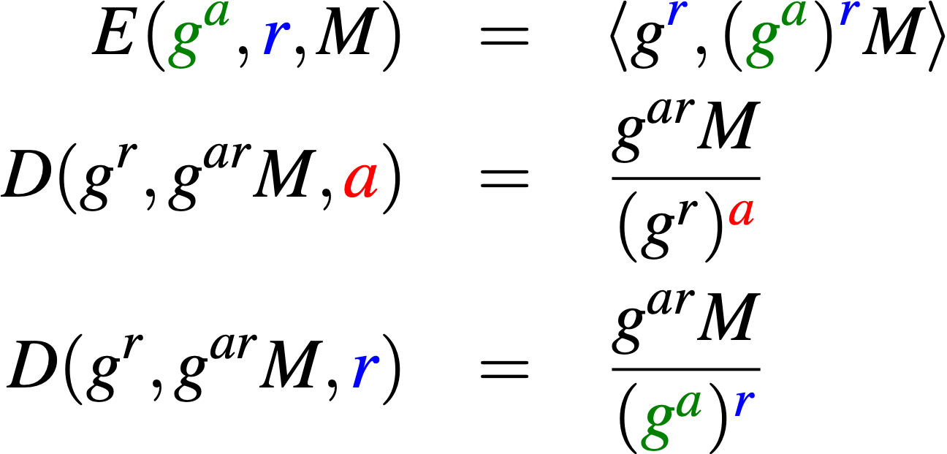

ElGamal extra goodies
Two ways to decrypt:
Only election officials (or trustees) have a (or shares of a) to decrypt totals.
When challenged, machine reveals random nonces (r), observer can decrypt.
g group generator
M plaintext (message)
r random (chosen at encryption time)
a (private) decryption key
(public) encryption key

Slide 35
Challenging the machine
When challenged, the machine must reveal r
We can then decrypt this ballot (only) and see if it’s what we expected to see
In Benaloh, the encrypted ballot is on paper
An irrevocable output medium
decrypting requires additional equipment
VoteBox (2008) has an irrevocable publishing system
In-precinct LAN, where all machines replicate the history, plus hash entanglement.
Helios (also 2008) just showed it to you on the web

Slide 36









polling place
challenge
center
commit ballot
tap
uploader
cast ballot
commit ballot
“data
diode”
challenge response
INTERNET
ALICE
challenge
verification
results
internet
device
observers
challenger
voter
Notes:
SLOW DOWN
Explain the step-by-step.

Slide 37
STAR challenges (2013)
Commitment: ciphertext broadcast to terminals
Happens when the ballot is printed, just like VoteBox
Challenge: voter deposits or keeps ballot
Challenger takes home printed ballot
Ballot randomness posted, anyone can decrypt (ballots not counted!)
Procedurally: same as a spoiled ballot
Big usability win
No need to ask the voter a challenge question
Simple “live parallel testing”
Notes:
Parallel testing: bring in video cameras, observers, anything you want, safe to interact with the voting machine, just not allowed to put anything in the ballot box.

Slide 38
STAR Workflow: Registration
Registration
Voter
Precinct 101A
Notes:
Barcode helps avoid subsequent data-entry error. Printed text helps poll worker double-check.

Slide 39
Workflow: Authorization
Registration
Controller
Voting terminals
Voter
Auth: 52794
Precinct 101A
Similar to Hart InterCivic eSlate

Slide 40
Workflow: Voting
Registration
Controller
Voting terminals
Voter

Slide 41

Workflow: Ciphertext copies distributed
Registration
Controller
Voting terminals
Voter

Slide 42
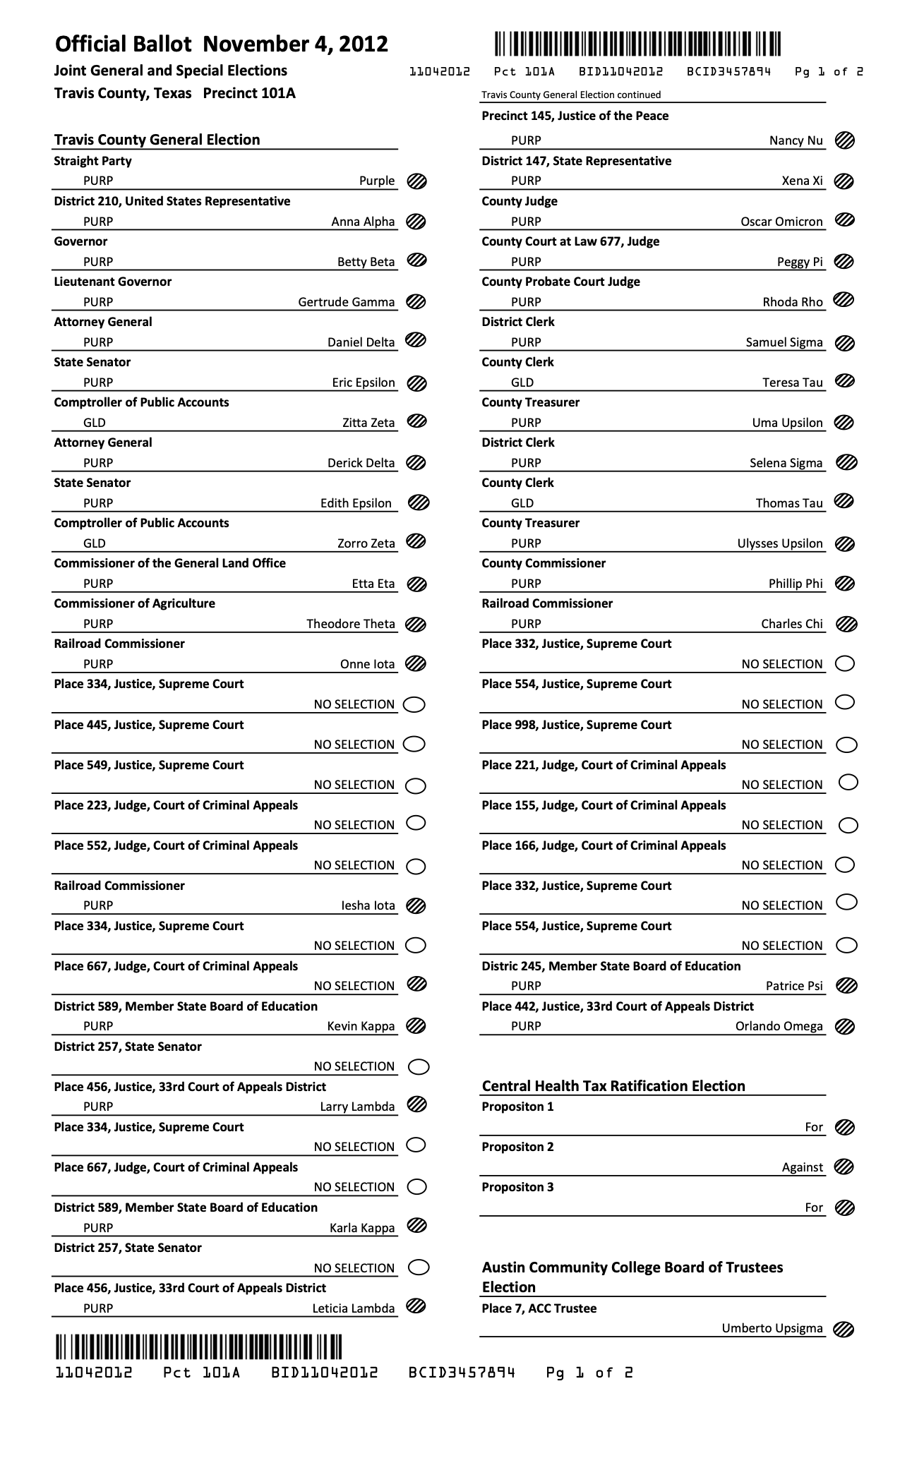
Workflow: Casting
Registration
Controller
Voting terminals
Voter
Ballot box

Slide 43
Networked ballot box
Notifies other machines that ballot was deposited
Ballot has random ID
Voter can spoil ballot and start over
Usability win!
Ballot box has no UI
Controller
Voting terminals
Ballot box
Deposit and done (just need a scanner for the ballot ID)

Slide 44
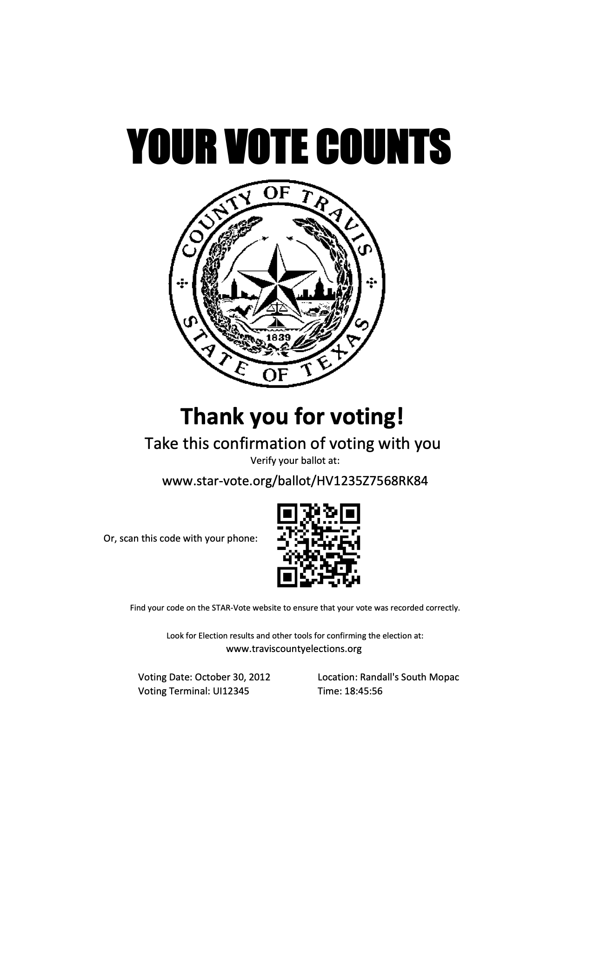
Post-election verification
Separate page to take home
Ballot hash for lookup on public bulletin board
Cast ballot: ciphertext will match
Challenge ballot: plaintext also present, verifiable
Homomorphic tallying: provably includes all ballots on the bulletin board
Hash chains: also publicly verifiable
Notes:
Hash in URL, can be processed locally

Slide 45
Risk limiting audits
Random sampling of individual paper ballots
Each should exactly match up with electronic records
Required in many states, growing in popularity
Requires touching tens of ballots, rarely hundreds, unlikely more
Mitigates malicious software in the ballot scanners
Discrepancies require more samples, degenerates to a full manual recount of the ballots

Slide 46
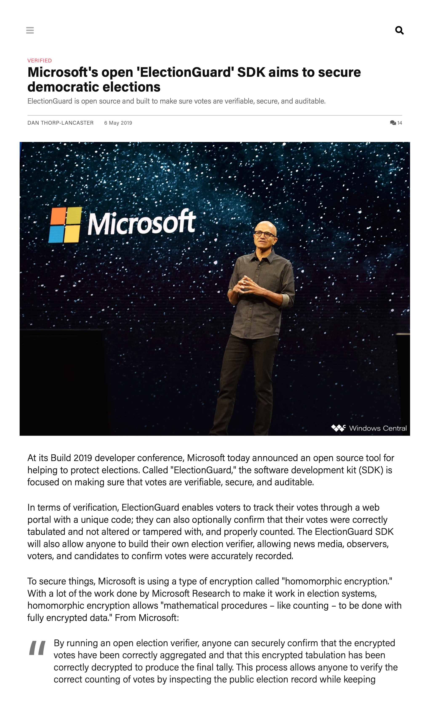
Voting + Cryptography

Slide 47
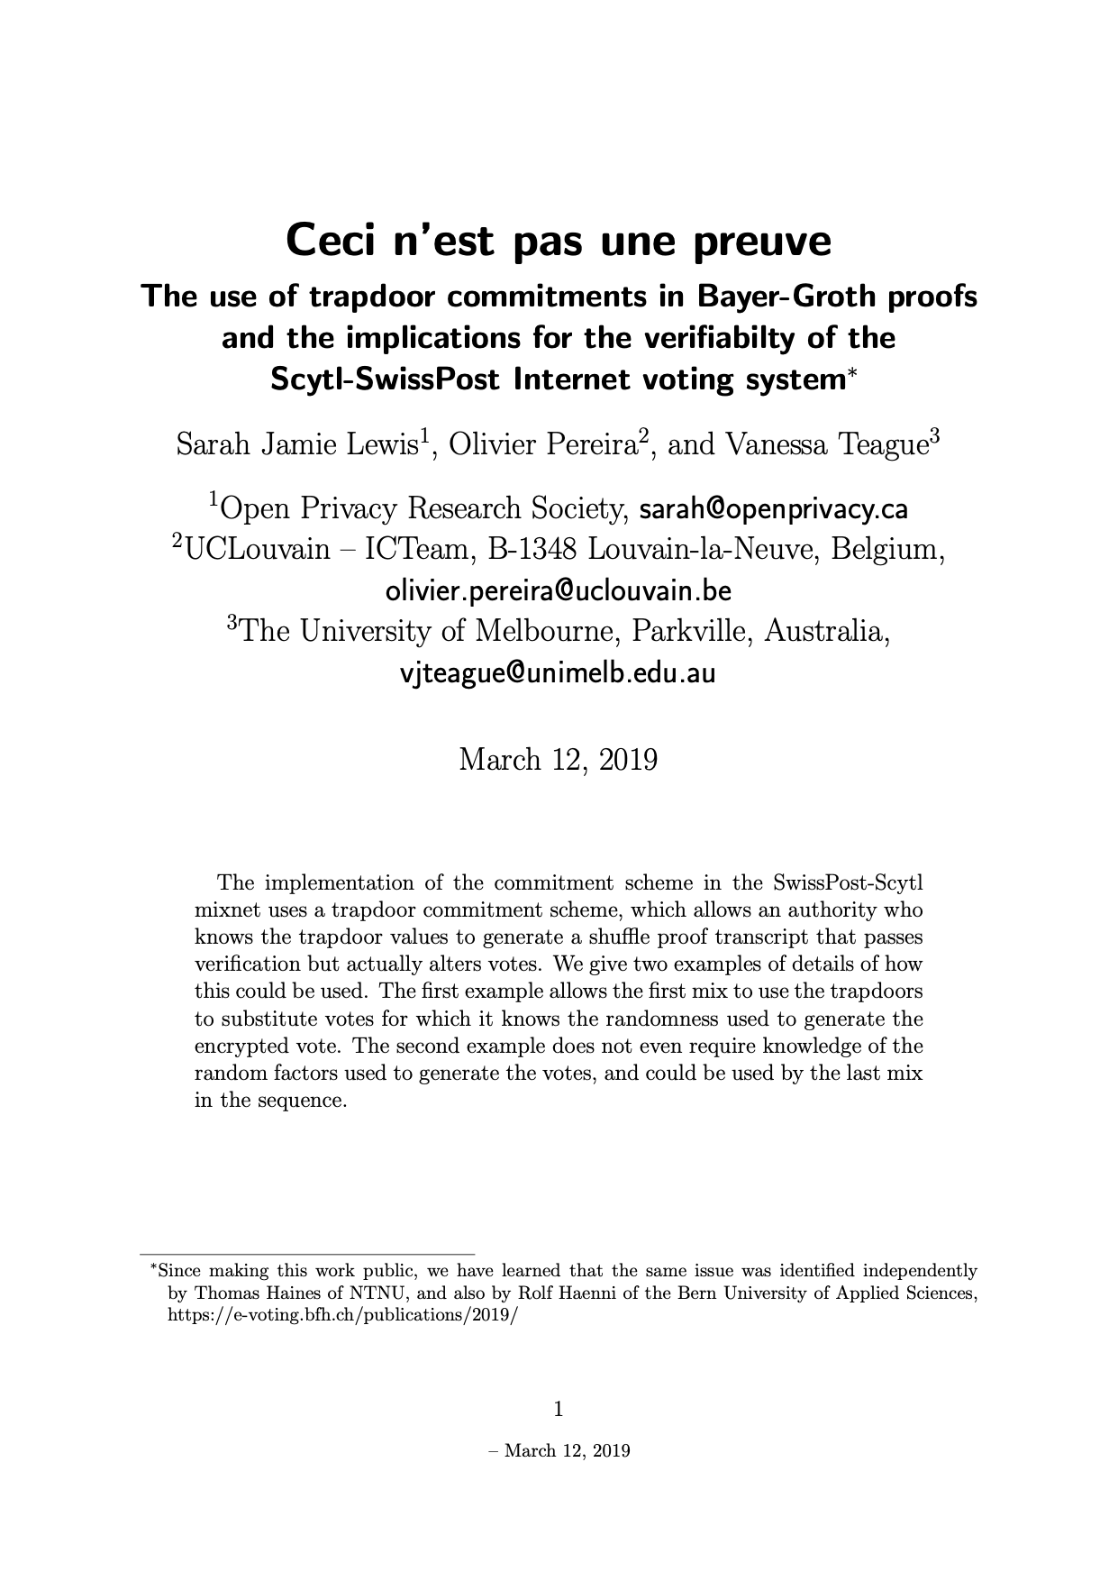
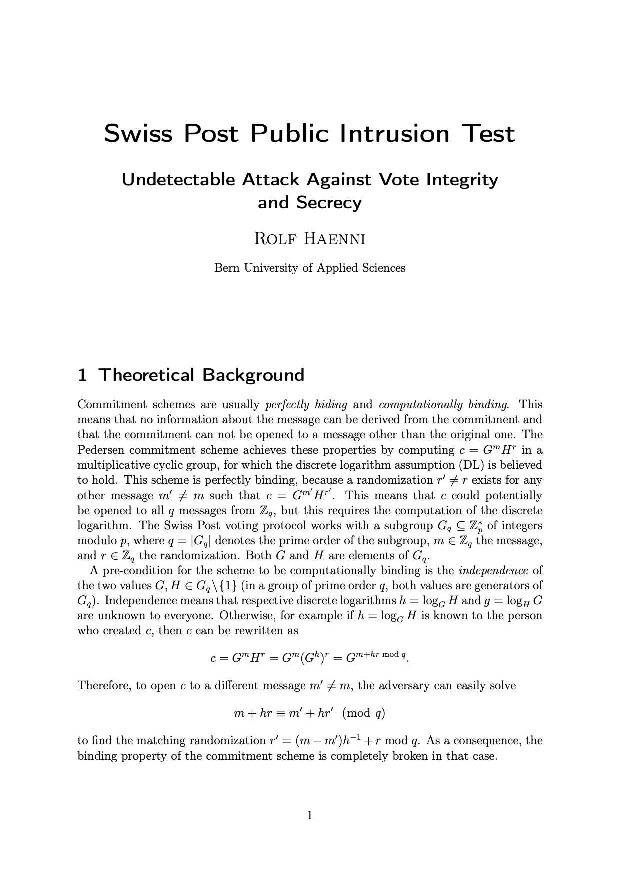
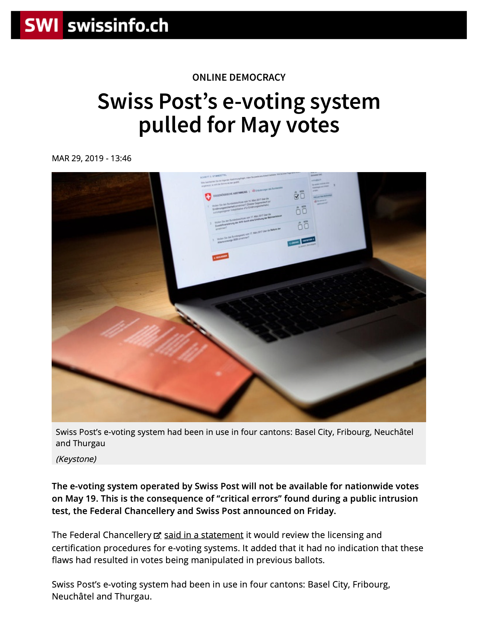
How not to do e2e cryptography

Slide 48
Will ElectionGuard be better?
Talented engineers & researchers from Microsoft Research, others (including Wallach)
Multiple current implementations (open source, online)
“Complete” implementation in Python
“Client-side” implementation in C/C++/C# (with some iOS/Android code as well)
“Deprecated” partial implementation in Rust
Original prototype: plugged into a branch of the VotingWorks BMD
Used in a January 2020 pilot election in City of Fulton, Wisconsin
The ElectionGuard model: open-source, verified libraries
Targeted outreach to election equipment vendors
Still requires in-precinct voting
Sophisticated cryptography doesn’t solve problems with internet voting

Slide 49
Will ElectionGuard be better?
Talented researchers from Microsoft Research, others (including Wallach)
Multiple current implementations (open source, on GitHub today)
Your project 1 (going online tomorrow!) is based on ElectionGuard
The ElectionGuard model: plugins for existing voting machines
Targeted outreach to election equipment vendors
Still requires in-precinct voting
Sophisticated cryptography doesn’t solve problems with internet voting

